Slide 1
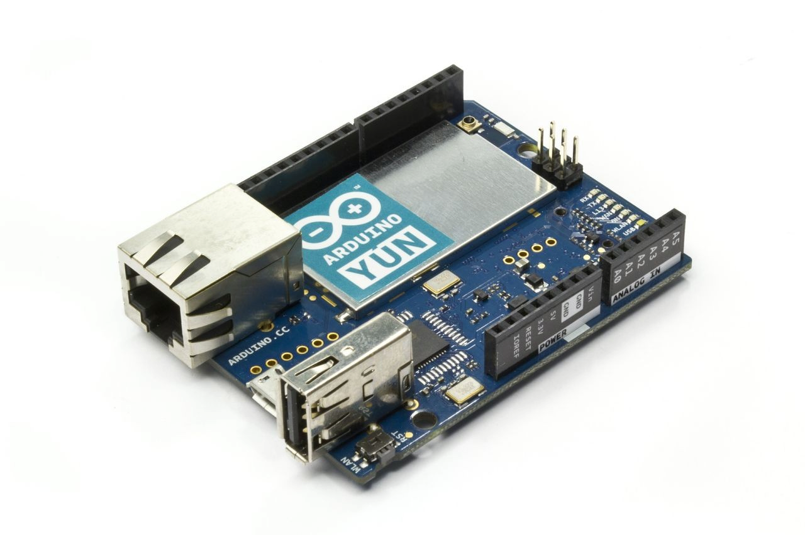
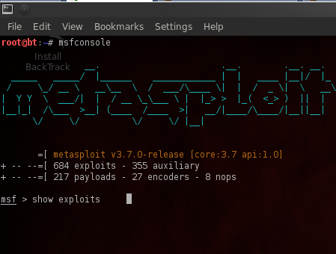
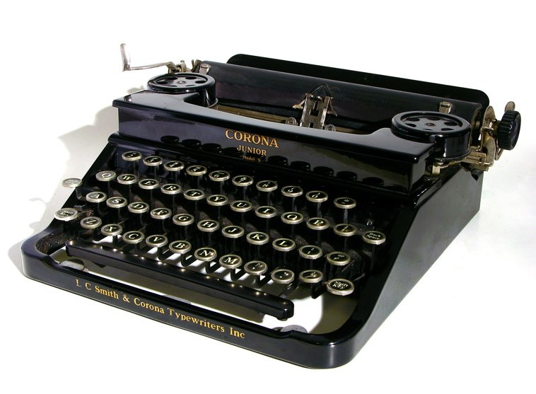
USB-HID, Meterpreter and Why Keyboard Programming Sucks
DEFCON26
Dr Mike Westmacott
Notes:
My Intro: Techie (code, pentest, malware analysis…) IA (threat modelling)
Thales is a systems integrator
TC&C Cyber security in gov, CNI,
Title: It’s a title I can’t answer – don’t know how many people, or things! But can I model trust?
Quote – “Trust is a peculiar resource, it is something that is built, rather than depleted over time” anon

Slide 2


Slide 3

Questions required throughout

Slide 4
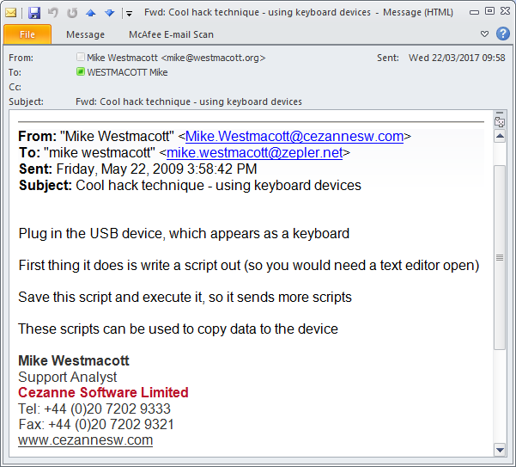
If you have a good idea, use it!
Notes:
My Intro: Techie (code, pentest, malware analysis…) IA (threat modelling)
Thales is a systems integrator
TC&C Cyber security in gov, CNI,
Title: It’s a title I can’t answer – don’t know how many people, or things! But can I model trust?
Quote – “Trust is a peculiar resource, it is something that is built, rather than depleted over time” anon

Slide 5
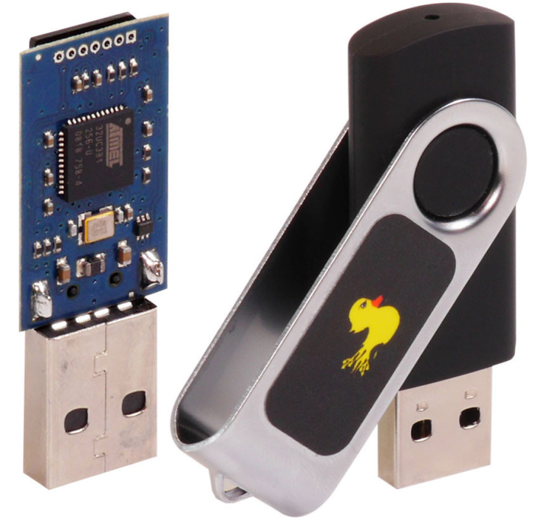
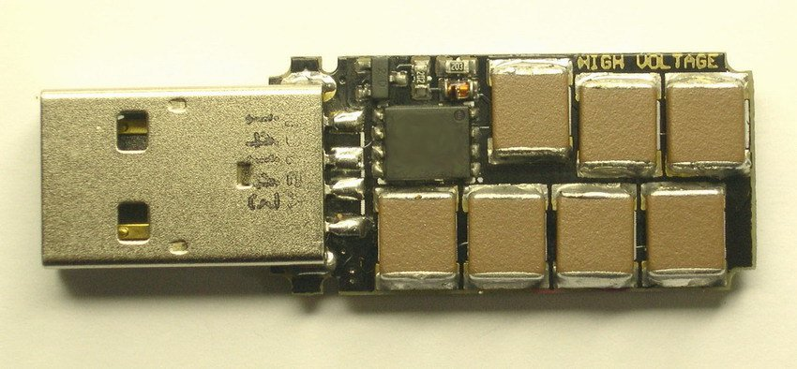
… because if you don’t others will
Notes:
My Intro: Techie (code, pentest, malware analysis…) IA (threat modelling)
Thales is a systems integrator
TC&C Cyber security in gov, CNI,
Title: It’s a title I can’t answer – don’t know how many people, or things! But can I model trust?
Quote – “Trust is a peculiar resource, it is something that is built, rather than depleted over time” anon

Slide 6
Goals and Objectives
* Auto generate scripts
* Exfil/infiltration of data and code
* Bridging of TCP?
* Metasploit connections?
Notes:
Discuss objectives
* Infil/exfil of data with no network
* Scripting of tools onto system
* Menu system in text editor
Discuss the overall architecture
*

Slide 7
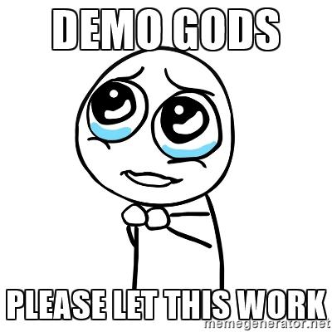
Notes:
Start VM
Logon
Start notepad
Start cmd
Arrange fonts and windows
Check addresses
SSH to Yun
Enable

Slide 8
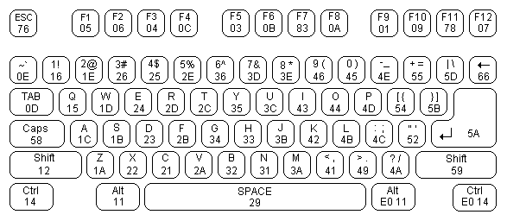
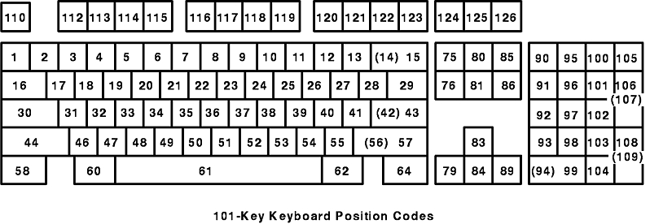
Keyboards
Notes:
Proper scancode/mapping/definitions?
Scancode is unique reference to physical key, with the action – up/down
In Linux exposed via event devices
Scancode must be mapped to

Slide 9
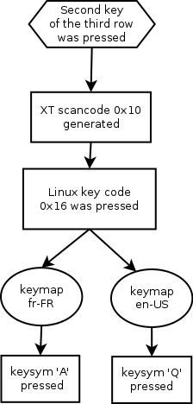
Notes:
Physical key pressed -

Slide 10
Pressing Keys
Notes:
Physical key pressed -

Slide 11
Typing in Binary
X5O!P%@AP[4\PZX54(P^)7C
C)7}$EICAR-STANDARD-ANTIVIRUS-TEST-FILE!$H+H*
U2VuZCBOdWRlcw==
Notes:
Talk about encoding stuff

Slide 12
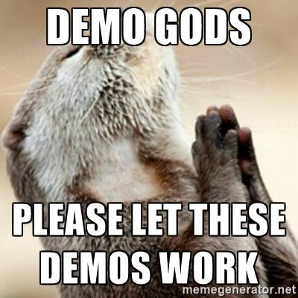

Slide 13
Batching and Scripting Techniques
Windows/MSDOS Batch must have LF at end of lines printed
Compile binary using only ASCII (EICAR) - .com
Use external tools – DEBUG, BASE64, CERTUTIL
Combine batch with stager

Slide 14
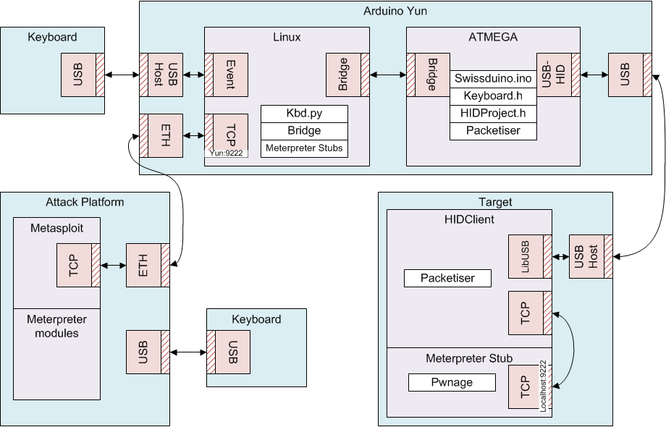
Architecture II

Slide 15


Slide 16
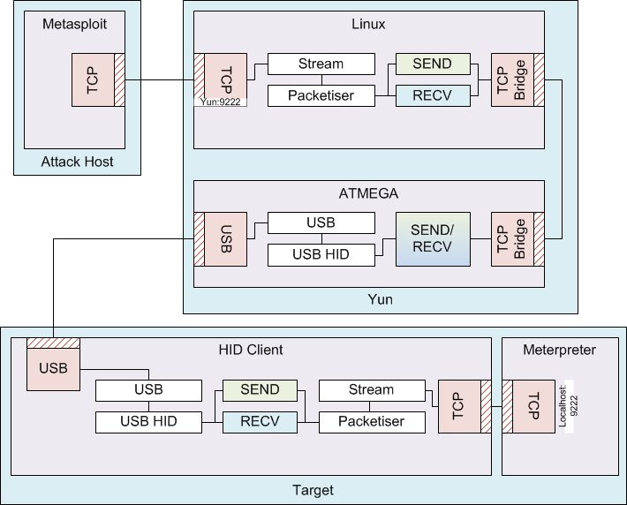
TCP – TCP Connectionless Bridge

Slide 17
Self Optimising Bridge

Slide 18
TCP Packet Bashing

Slide 20
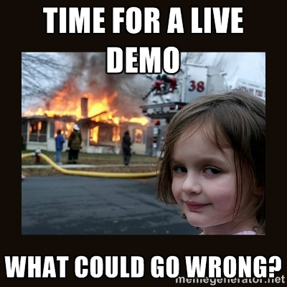

Slide 21
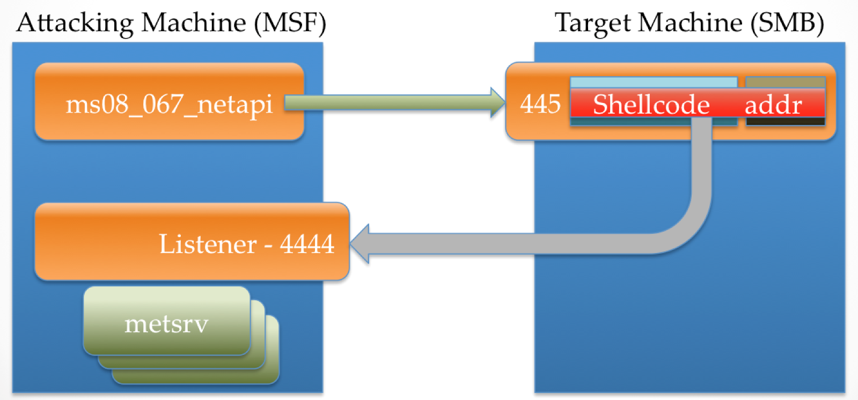
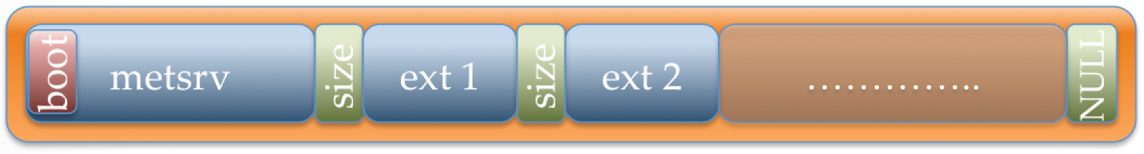
Meterpreter Staged vs Stageless
Stageless

Slide 22
Moving Forward
Yun Bridge = much slowness
Pi Zero = dual USB: 1 OTG port
All Linux – can use gadgets
Serial CDC
Mass Storage
HID
Projects
Someone’s started a USB framework. Forgot where :(
Group Discussion!
Mitigations
Other uses

